Slide 1
Business Review January–September 2023
Sami Sivuranta
President and CEO
Componenta Corporation
Finland's leading contract manufacturer of metal components

Slide 2
The result for January–September 2023
Key figures
Net sales increased and was EUR 80.1 million (EUR 79.0 million)
EBITDA improved and was EUR 5.8 million (EUR 4.3 million)
The operating result was EUR 5.7 million (EUR 0.1 million) *
Cash flow from operating activities was EUR 2.7 million (EUR 2.7 million)
Financing
The Group's cash and cash equivalents at the end of September were EUR 8.3 million (EUR 6.5 million)
At the end of the review period, the group had a subscription limit of USD 8.0 million, of which the unused portion was USD 7.5 million
Componenta had unused binding revolving credit facilities of EUR 4.0 million (EUR 4.0 million)
The Group's liquidity was at a very good level at the end of the review period
Market situation
Due to market uncertainty, the development of end customers' order book has slowed down in some places
The availability of raw materials and materials is currently good, which is also reflected in the customers' inventory management. The cost level of material purchases has in some respects decreased during the review period
The availability of electrical energy is good, and the price development has steadied
*The operating result of the review period includes a non-recurring profit of EUR 4.2 million from the reversal of the impairment loss related to the production machinery and equipment of the foundry business

Slide 3
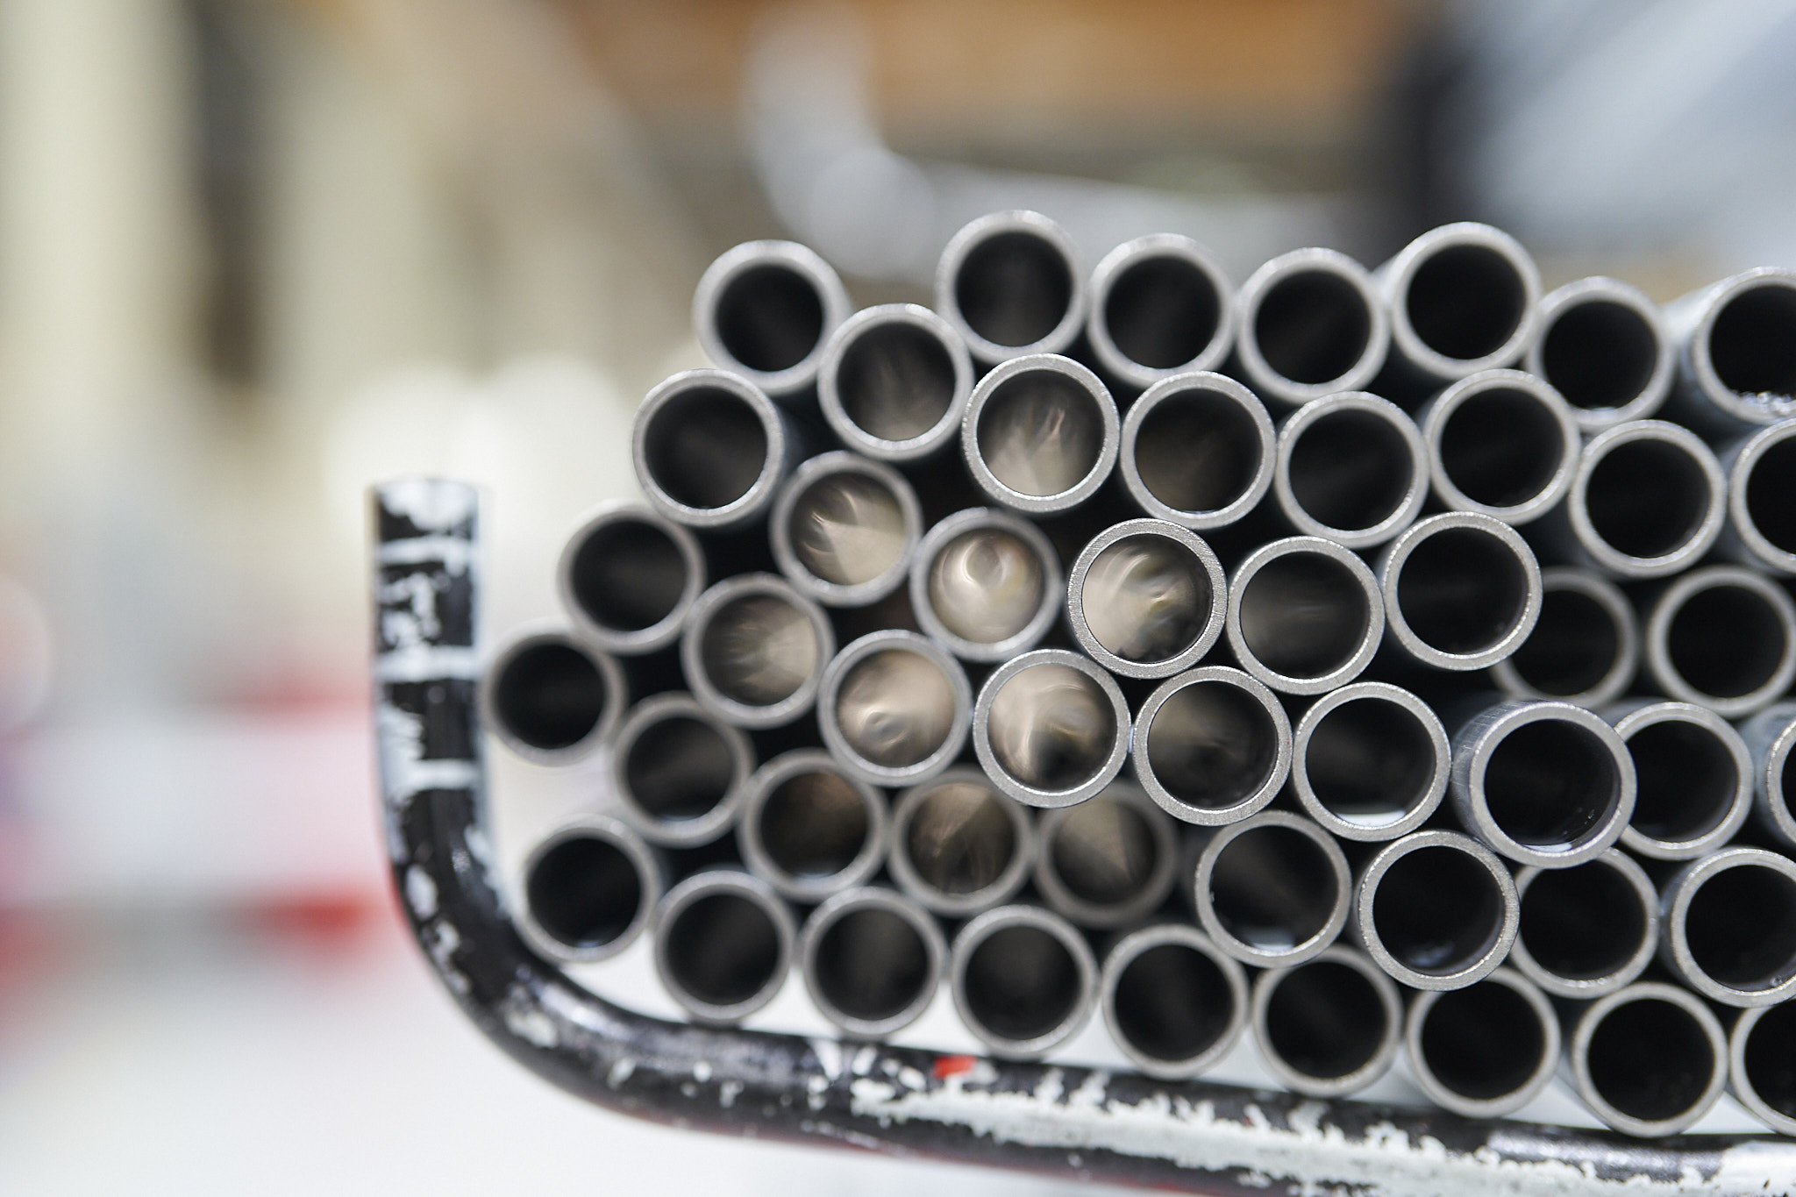
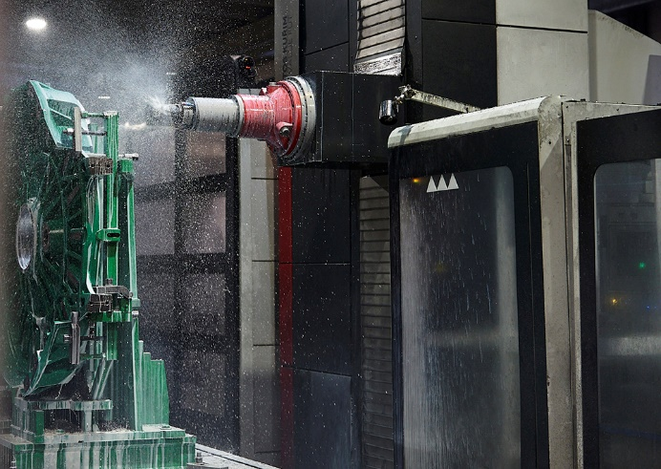
Topical during the reporting period
Customers and order book
General market situation and decision-making
Production volumes and market shares and their development
Stock optimizations and adaptation of operations
Development of raw material and electrical energy indices and other sales price changes
Operating environment
General economic situation and effects of geopolitical crises
Energy cost development and predictability
Availability of materials and components and expectations of cost development
Personnel and own actions
Flexibility, resilience and commitment of our own personnel
Adapting to production needs and maintaining service capability
Ensuring the procurement of materials and raw materials and cost development

Slide 4
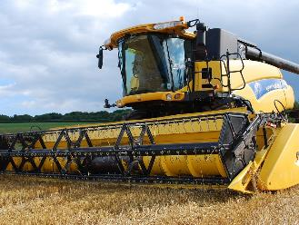
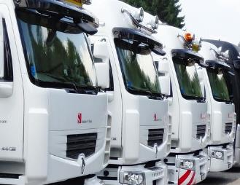
Net sales by customer segments
Machine building
Agricultural and forestry machinery
Energy industry
Defense equipment industry
Other industries
43 % (48 %)
41 % (37 %)
8 % (8 %)
3 % (1 %)
5 % (6 %)
Figures January−June 2023 (January−June 2022)

Slide 5
Net sales

Slide 6
EBITDA

Slide 7
Cash flow from operating activites

Slide 8
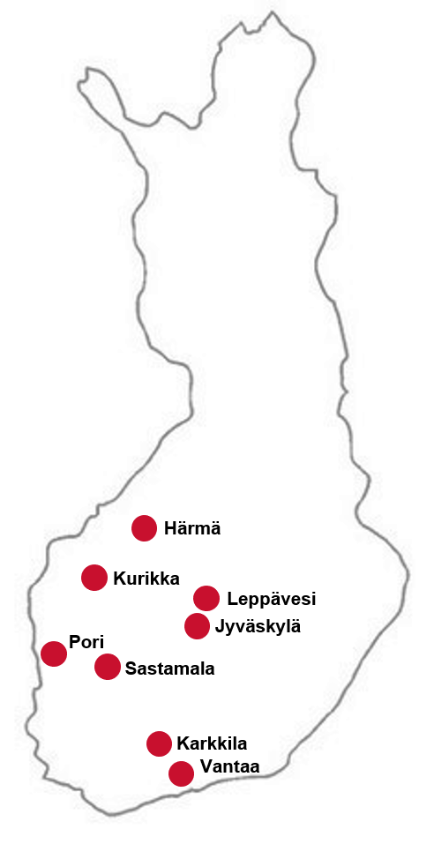
Componenta in brief
Component contract manufacturing
Customers are global manufacturers of vehicles, machines and equipment
Key figures
Jan‒Sep/ Jan‒Sep/ 2023 2022
Net sales, EUR million 80.1 79.0
EBITDA, EUR million 5.8 4.3
Operating profit, EUR million 5.7 0.1
Cash flow from operating activities, EUR million 2.7 2.7
̴ 591
Guidance 2023
Componenta expects the net sales to be EUR 100–105 million in 2023. EBITDA is expected to be EUR 6–7 million.

Slide 9
In focus in 2023
Availability of materials, development of purchase and sale prices, and the situation in the electricity market
Our goal is to be the primary total supplier of contract manufacturing
Continuous improvement of profitability
We will continue to invest in strengthening our market position
Development of own operations, occupational safety and targeted investments
From a technology-centric approach to a deeper customer orientation
In our customer relationships, we invest in active dialogue and maintaining customer satisfaction
Expectations, plans and measures 2024

Slide 10
Responsible contract manufacturer
Responsibly together with customers and suppliers
Componenta's business is based on a circular economy
Safety and personnel well-being at the heart of what we do
Responsible total supplier
Long-term customer relationships
Close to the customer
Developing of supplier network
Expanding the offer through a subcontracting network
Our values: openness, honesty and respect
600 skilled and committed employees
We invest in the health and safety of our personnel
We support the diversity and equality of our personnel
The important role of the circular economy in production processes
Continuous improvement of energy efficiency
Certified quality, environmental and occupational safety systems

Slide 11
Componenta´s strategy 2020‒2023

Slide 12
Thank you!

